Slide 1
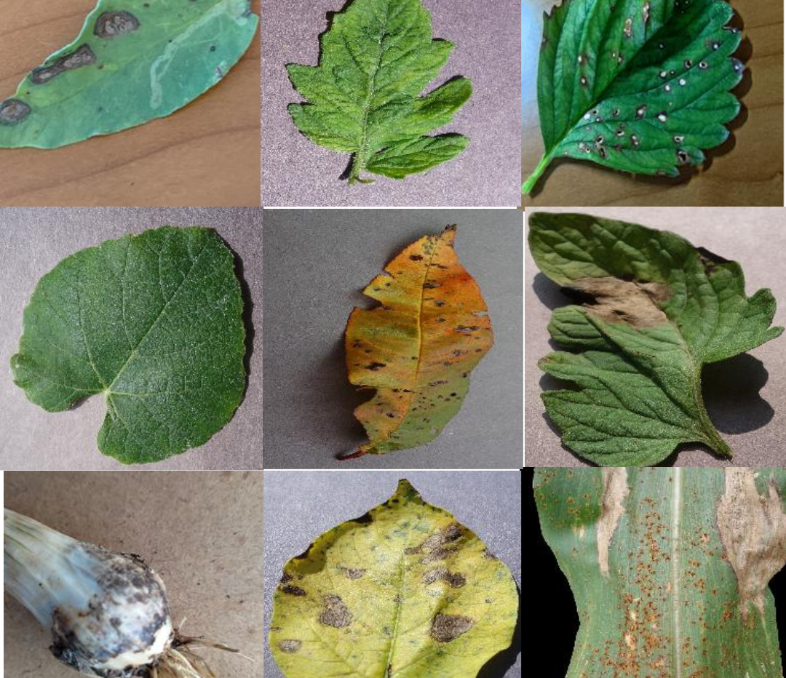
Image-Based classification of plant diseases
Big Data Computing Project
Jessica Frabotta - 1758527

Slide 2
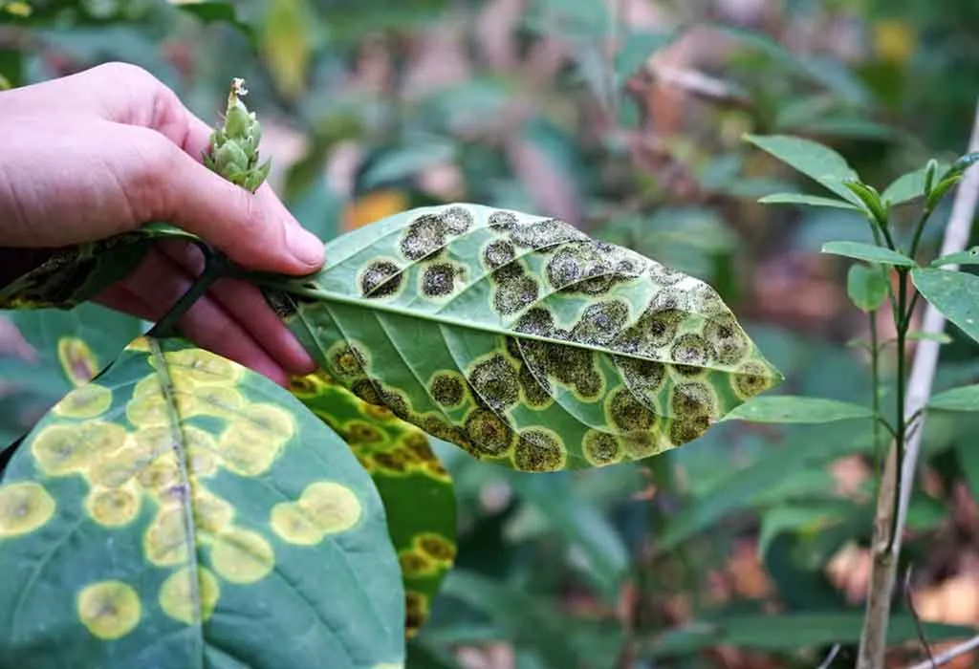

index
Dataset
Convolutional Neural Network
Multilayer Perceptron
Random Forest
Performance comparison of all models
Application

Slide 3
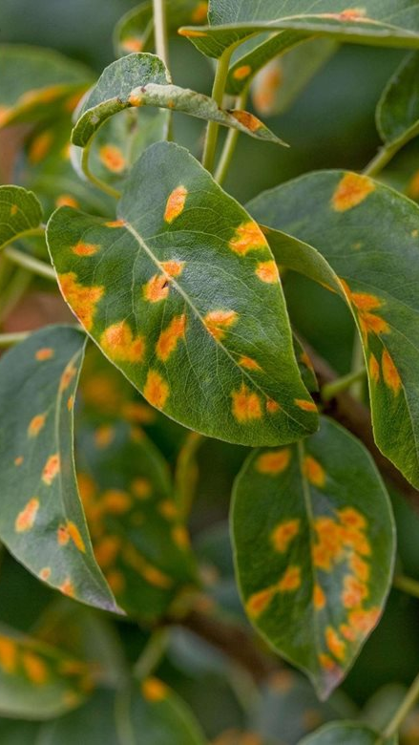
Introduction
This project is focalized on how to identify and classify plant diseases using ML models and Spark. It is a multi-class classification task (there are 30 different classes). I used a combination of the popular PlantVillage dataset and a dataset which was constructed by me.

Slide 4
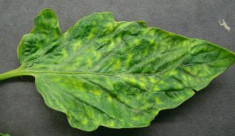
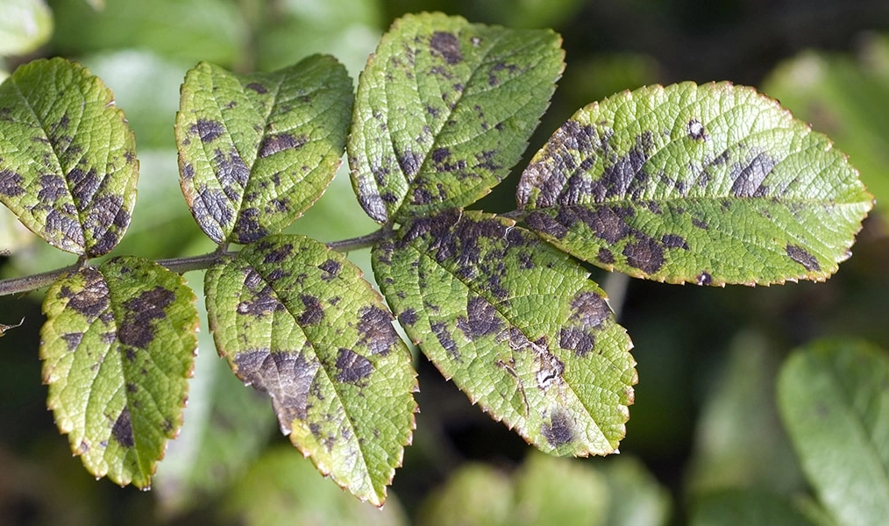
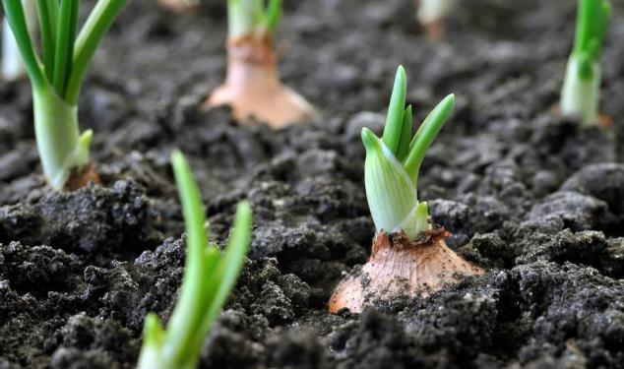
Dataset
My Dataset
PlantVillage
Combined Dataset

Slide 5
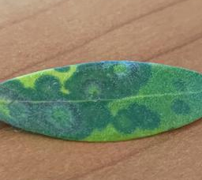
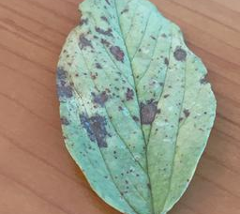
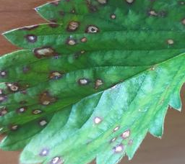
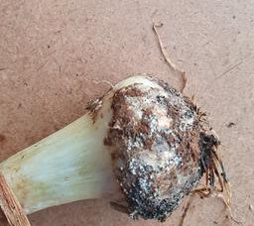
MY DATASET
7 of the classes of the dataset used are from a dataset which I collected. My full dataset with 16 classes and 15157 images is also available on Kaggle.

Slide 6

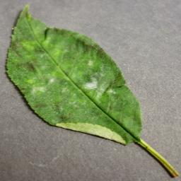
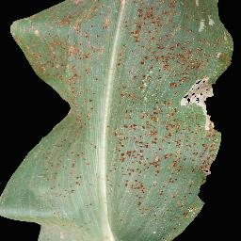
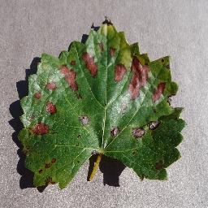
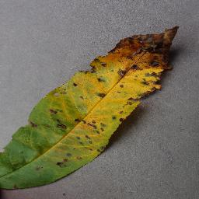
PlantvILLAGE
23 of the classes of the dataset used are from the popular dataset PlantVillage dataset.
Combined dataset
The overall combined dataset is composed of 43910 images.

Slide 7
Convolutional neural network
Horovod
Performance

Slide 8
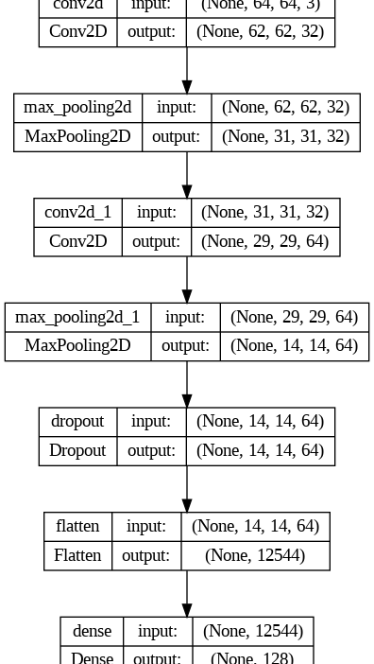
Horovod
Convolutional Neural Networks, or CNNs, are a type of deep learning neural networks which are particularly efficient for image classification tasks.
Convolutional Neural Networks are not natively supported by PySpark. Horovod allows to train directly on a Spark DataFrame and to create deep learning models with Keras or PyTorch. The training of the model is distributed thanks to Spark.

Slide 9
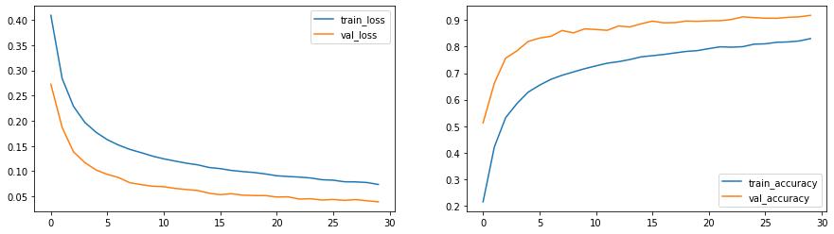
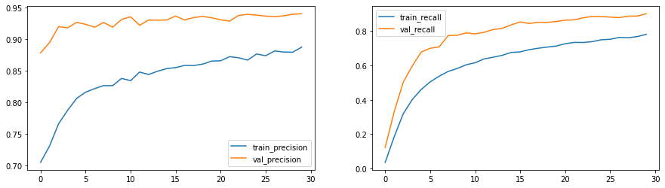
Performance

Slide 10
Multilayer perceptron
Architecture and performance

Slide 11
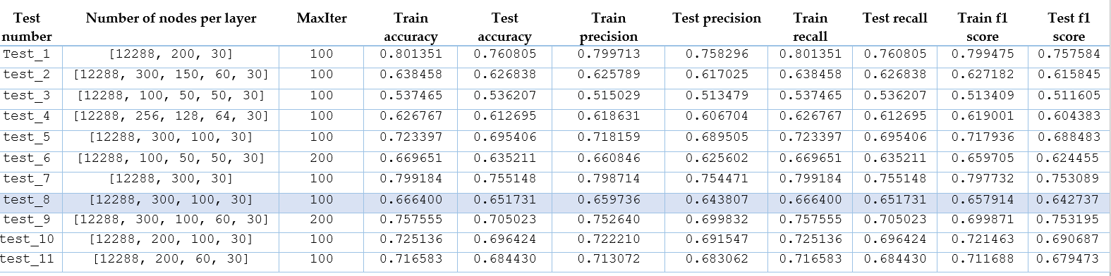
Architecture and performance
A Multilayer Perceptron (MLP) is a type of artificial neural network that is composed of multiple layers of interconnected artificial neurons, which are the basic processing units of a neural network. MLP is natively supported by PySpark. In its implementation each layer has sigmoid activation function, output layer has softmax.

Slide 12
Random Forest
Random Forest
DNN featurization and Transfer Learning
SynapseML
Performance comparison

Slide 13
Random forest
Random Forest is a machine learning algorithm used for classification and regression tasks. It is based on the idea of creating an ensemble of decision trees and combining their predictions to arrive at a final prediction. It is natively supported by PySpark. I compared the performances of two different implementations:
SIMPLE RANDOM FOREST
RANDOM FOREST WITH DNN FEATURIZATION AND TRANSFER LEARNING

Slide 14
DNN featurization
DNN Featurization involves using a deep neural network to extract features from raw data, such as images, and transform them into a compact and meaningful representation that can be easily used as input to a machine learning model (in my case a random forest).
TRANSFER LEARNING
The idea behind transfer learning is to leverage the knowledge learned by the pre-trained network on a large dataset and transfer it to the new task, where the training data may be limited.

Slide 15

Synapse ml
SynapseML (previously known as MMLSpark), is an open-source library built on the Apache Spark distributed computing framework. SynapseML allows to download and use pretrained models to implement DNN featurization and transfer learning. Given my limited resources, I had to use a very simple pretrained network: a Convolutional Neural Network trained on the popular CIFAR-10 dataset (requires images of size 32x32).
SynapseML also offers interesting integrations with OpenCV so I extensively used it also in the data preprocessing step.

Slide 16
performance comparison
 | Test accuracy | Test precision | Test recall | Test f1 score
RANDOM FOREST WITH DNN FEATURIZATION AND TRANSFER LEARNING | 0.53 | 0.53 | 0.53 | 0.53
SIMPLE RANDOM FOREST | 0.18 | 0.24 | 0.18 | 0.12

Slide 17
performance comparison of all models
Performance comparison of all models

Slide 18
performance comparison of all models
 | Test accuracy | Test precision | Test recall | Test f1 score
CONVOLUTIONAL NEURAL NETWORK | 0.92 | 0.92 | 0.92 | 0.92
MULTILAYER PERCEPTRON | 0.65 | 0.65 | 0.66 | 0.64
RANDOM FOREST WITH DNN FEATURIZATION AND TRANSFER LEARNING | 0.53 | 0.53 | 0.53 | 0.53

Slide 19
Application
Streamlit demo

Slide 20
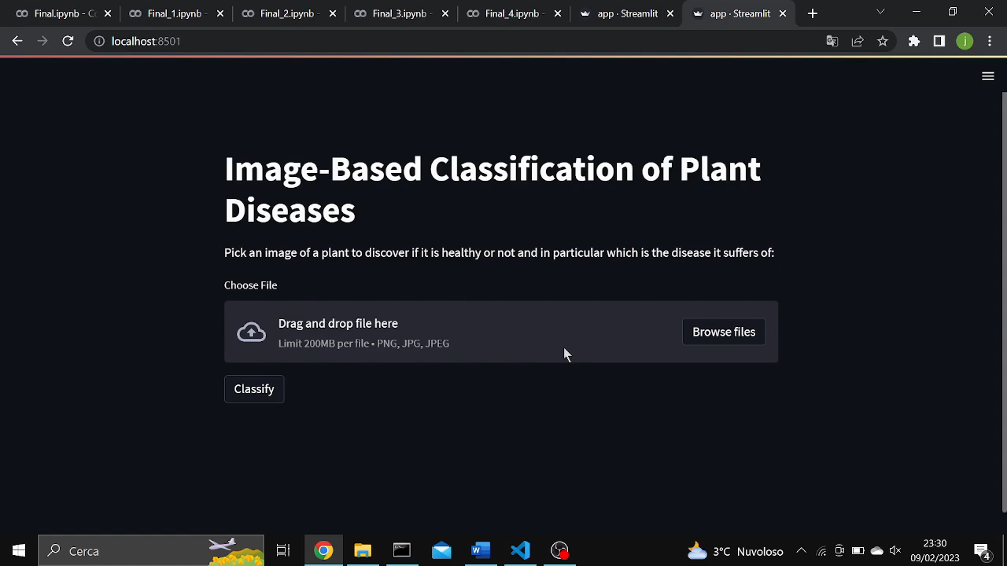
STREAMLIT DEMO

Slide 21
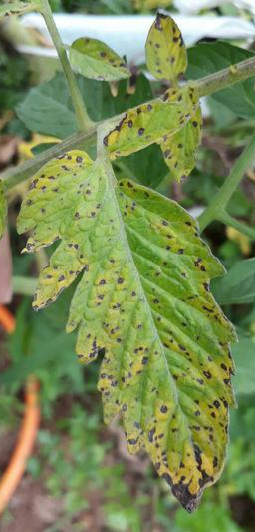
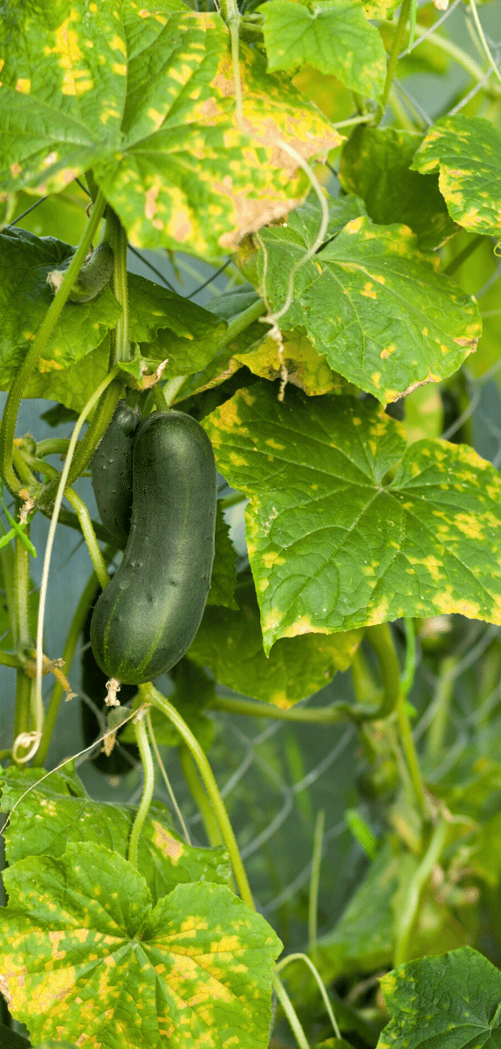
Thank you
Jessica Frabotta
frabotta.1758527@studenti.uniroma1.it

